Slide 1
IFTA Chronicles -Yesteryear
Presenters:
Donna Burch (Ryder)
Karen Smith (IA)

Slide 2
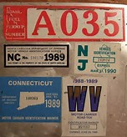
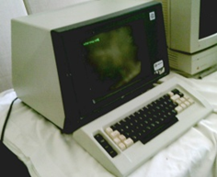
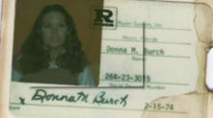
IFTA Chronicles -Yesteryear

Slide 3
First, a little history…
30 Years Ago –
Fuel Use Taxes Are a Crisis
for the Trucking Industry:
Non-uniform
Burdensome
Expensive to Administer and Comply With

Slide 4
Non-Uniformity:
Vehicles
Registration
Credentials
Bonds
Leases
Tax Reports
Credits & Refunds
Audit & Administration

Slide 5
Vehicles Reported
> all commercial vehicles
> 2 axles
> 7,000 lbs. empty wt.
> 10,000 lbs. empty wt.
> 18,000 lbs. GVW or 7,500 lbs. empty wt.
> 16,000 lbs. GVW
> 30 gallon fuel tank capacity
& at least 16 other definitions

Slide 6
Registration
Annual, biennial, or permanent
One-time fees per fleet
Annual fees per fleet
Annual fees per vehicle
Licenses for each place of business
Renewable in October, December, January, March, April, or July
Vehicle-specific cab cards
Account nos. on vehicle

Slide 7
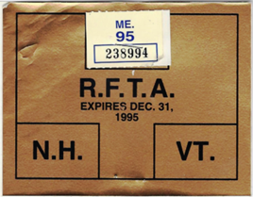
Credentials (DECALS!)
1 per vehicle – or 2?
On left side, right side – or front?
Display dates?
Annual, biennial – or permanent?
Fees?
YOU BETCHA! Charged by 22 states –TOTAL ANNUAL FEES PER TRUCK: $331.70

Slide 8
Bonds
Required by 19 states
Various amounts and limits
Required for refunds in 10 more states
Alternative security rarely allowed

Slide 9
Leases
Who’s responsible for reporting?
Lessee?
Lessor?
Party buying fuel?
Vehicle operator?
Up to parties?
State permission needed?
Depend on term of lease?
Copy required in vehicle?

Slide 10
Tax Reports
Frequency: monthly, quarterly, annually
Due date: 20th, 25th, 30th, last of month
Postmark honored?
Format
Computation of tax
Vehicles covered? Formula? State MPGs?
Individual vehicle MPGs?
Supporting documentation required
Payment in certified funds

Slide 11
Credits & Refunds
Do credits carry over?
How long?
Refunds available?
Minimum amount?
Audit first?
Documentation?
Other restrictions?

Slide 12
Audit & Administration
Record requirements
Official fuel receipts
Original documents
Frequent changes in requirements
Rules inaccessible to taxpayers
Multiple audits under different rules
LOTS of Gotchas

Slide 13
Fuel Use Taxes in 1983
Non-uniform ? Definitely
Burdensome ? For carriers of all sizes
Expensive ? US DOT: $1 billion a year in administrative costs for motor carriers

Slide 14
IFTA
First implemented 1983 - 3 members
Redrafted per NGA 1986 - 4 members
Required by ISTEA 1991 - 14 members
ISTEA deadline 1996
IFTA Re-codified 1995-98
Today - 58 members

